Slide 1
Create beautiful websites using PSHTML and Polaris
Van Gulick Stéphane
Notes:
This is the slide shown before the presentation starts. When you are ready to go, tell the video operator to start the recording, and click to the next slide.

Slide 2
5
Video operator, did you start the recording?
Notes:
[REQUIRED SLIDE]
These slides are mandatory and help us with video post-processing. Please keep them as they are.

Slide 3
4
Notes:
[REQUIRED SLIDE]

Slide 4
3
Notes:
[REQUIRED SLIDE]

Slide 5
2
Notes:
[REQUIRED SLIDE]

Slide 6
1
Notes:
[REQUIRED SLIDE]

Slide 7
Create beautiful websites using PSHTML and Polaris
Stéphane van Gulick
Notes:
This is your opening. Now the stage is yours!

Slide 8
How to insert your Twitter handle
1. On the Insert tab, select Header & Footer.
2. On the Slide tab, check the Footer box.
3. In the box below Footer, type your Twitter handle (e.g. @PSConfEU).
4. To prevent the footer from appearing on the title slide, check the Don't show on title slide box.
5. Click Apply to All button.

Slide 9
This Session
PSHTML fundamentals
Web dev skills
Static html pages
Dynamic html pages
Create a web application with Powershell
Notes:
Please invest some time to reconsider your session: what is it that audience can get out of it? Try and be as precise as you can. If you are showing solutions, then focus on “how to”. If you present about a general technology, you’ll want to stick to “Be able to” or “Understand why/how”.

Slide 10
Agenda
Introduction to PSHTML
What it is?
How to use it?
Basic and advanced functionality
Introduction to Polaris
What it is?
Basic use case
Using PSHTML and Polaris together
Notes:
Psconf.eu is about demos and code. Try and minimize use of text slides

Slide 11
Introduction to PSHTML

Slide 12
What is PSHTML ?
Cross platform powershell module
Reproduces HTML language
Domain Specific Language (aka DSL)
Integrates very well with PowerShell

Slide 13
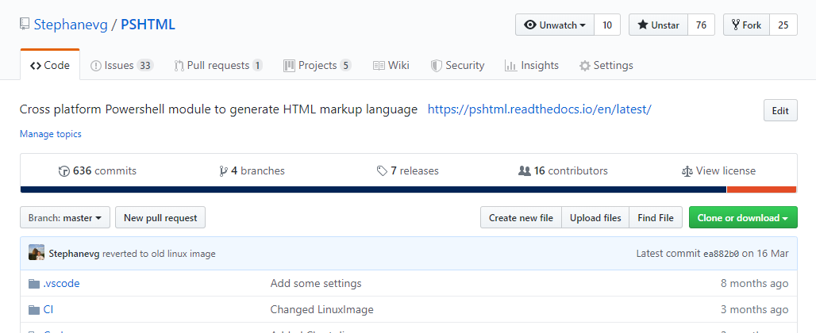
PSHTML
Getting started -> https://pshtml.readthedocs.io/en/latest/
Github -> https://github.com/Stephanevg/PSHTML

Slide 14
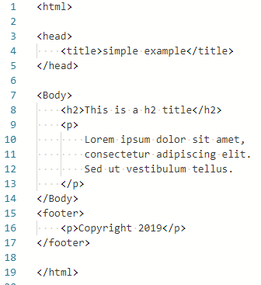
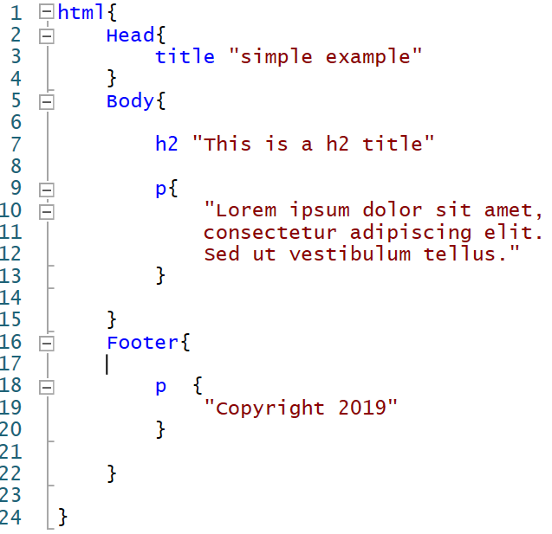
PSHTML
HTML
PSHTML

Slide 15
PSHTML introduction

Slide 16
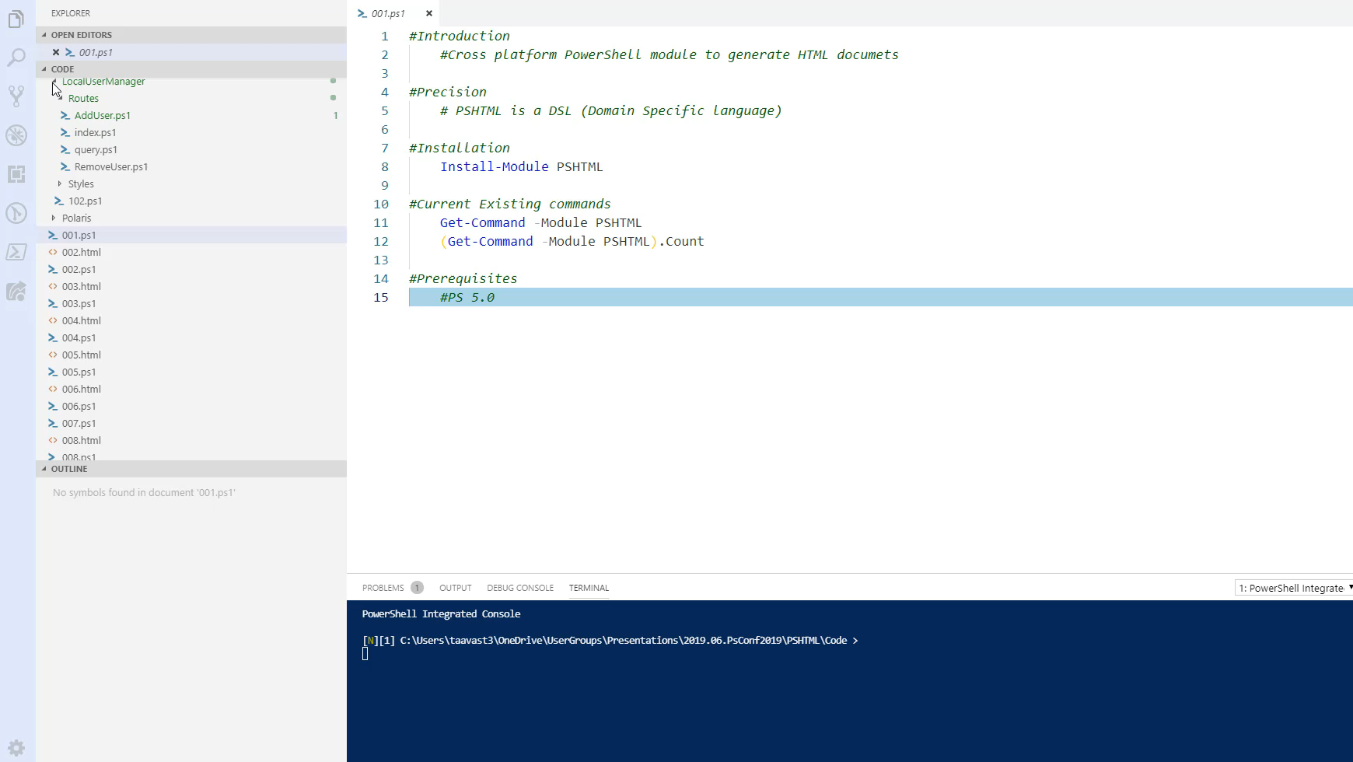
Notes:
How to install
Number of commands
Basic html page

Slide 17
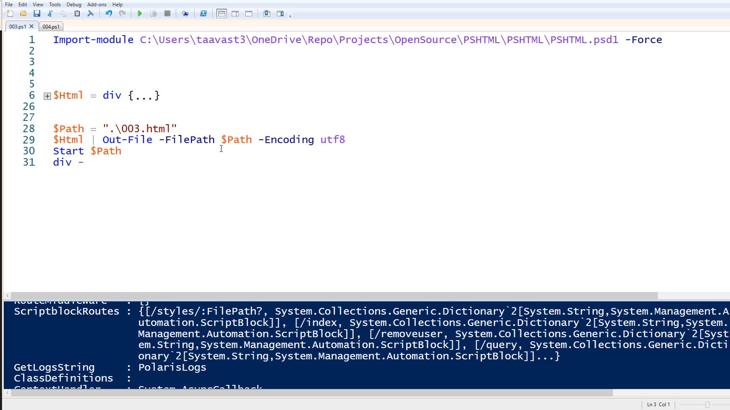
Notes:
Show tags
Id,Class,Style,attributes,content (003.ps1)
Create table raw (004.ps1)
Create table using ConvertTo-PSHTMLTable (005.ps1)

Slide 18
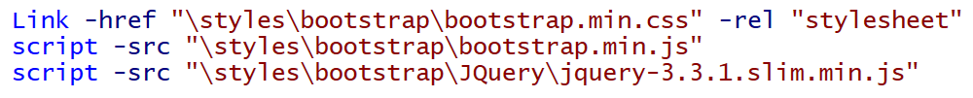
Cmdlet structure / HTML Tags
TagName
link
Content
href
Id
rel
Class
Style
Attributes
Notes:
-link
-href are actually attributes from 'link' tag

Slide 19
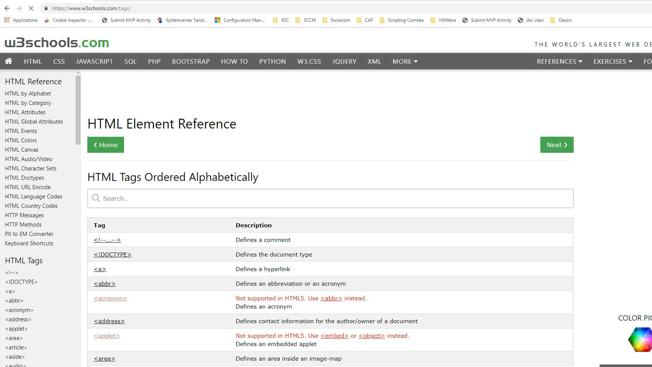
Notes:
1min20

Slide 20
Missing tag / Attribute?
All HTML tags 'should' be available
Missing attribute? -> Use -Attributes
Open issue -> https://github.com/Stephanevg/PSHTML/issues

Slide 21
PSHTML Tables
Tables
Create full structure
Dynamically generated
Table,Thead / Tr / tbody…
ConvertTo-PSHTMLTable

Slide 22
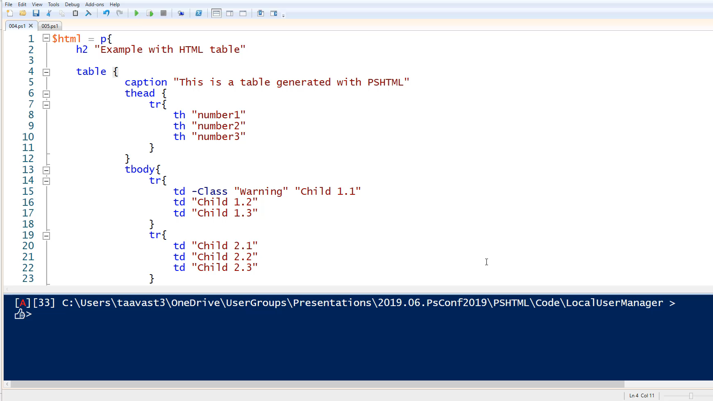

Slide 23
PSHTML Includes
Reusing same code across pages

Slide 24
PSHTML: Includes
Encapsulate identical code blocks
Code reuse
Reduce the refactoring scope

Slide 25
Using includes

Slide 26
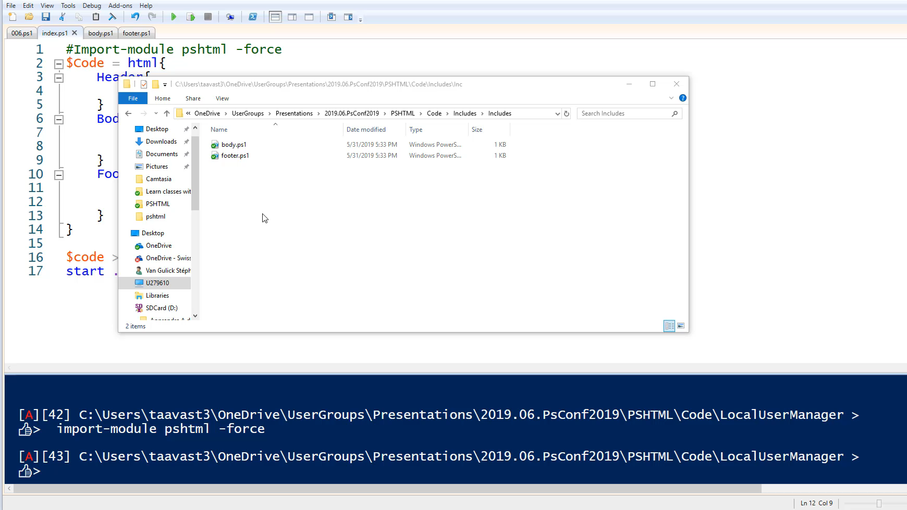

Slide 27
PSHTML: Using powershell
Adding logic and using powershell modules

Slide 28
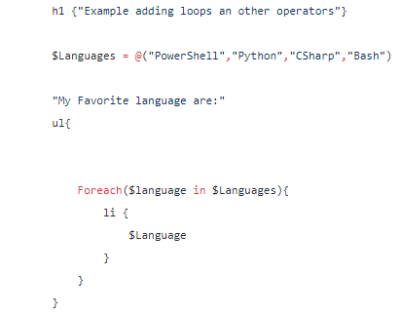
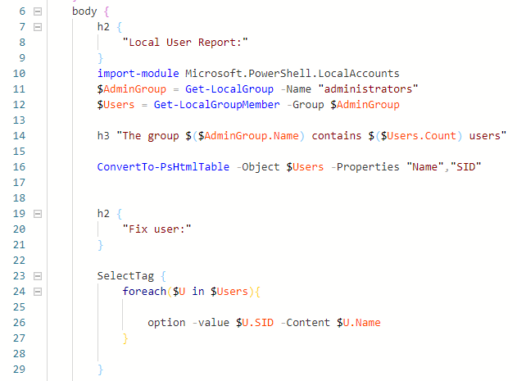
Using powershell
All powershell logic is available
use any powershell module
Notes:
Using external modules
Adding logic

Slide 29
Using all the power of powershell

Slide 30
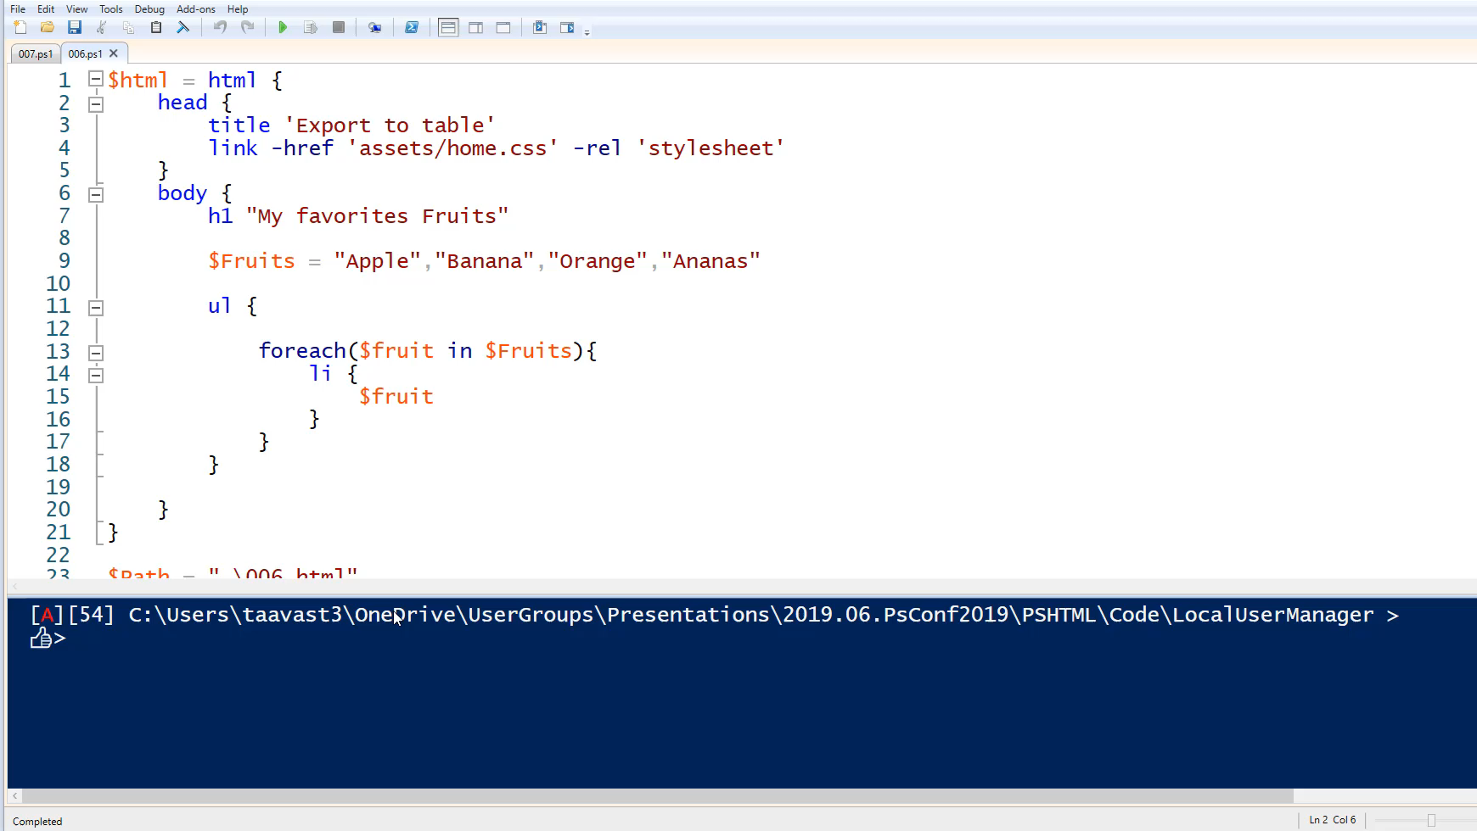

Slide 31
Working with Assets
Adding power to your HTML pages

Slide 32
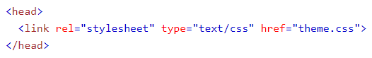
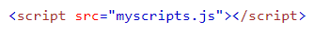
PSHTML Assets
CSS
Scripts (Javascript)

Slide 33



PSHTML Assets

Slide 34
Using assets – integrating external libraries in your PSHTML scripts
Notes:
Add a custom CSS file -> Show tab completion
Add custom JS file -> show tab completion
Show Jquery,BootStrap ChartJS
Generate once with all lines
Generate with Write-PSHTMLAsset

Slide 35
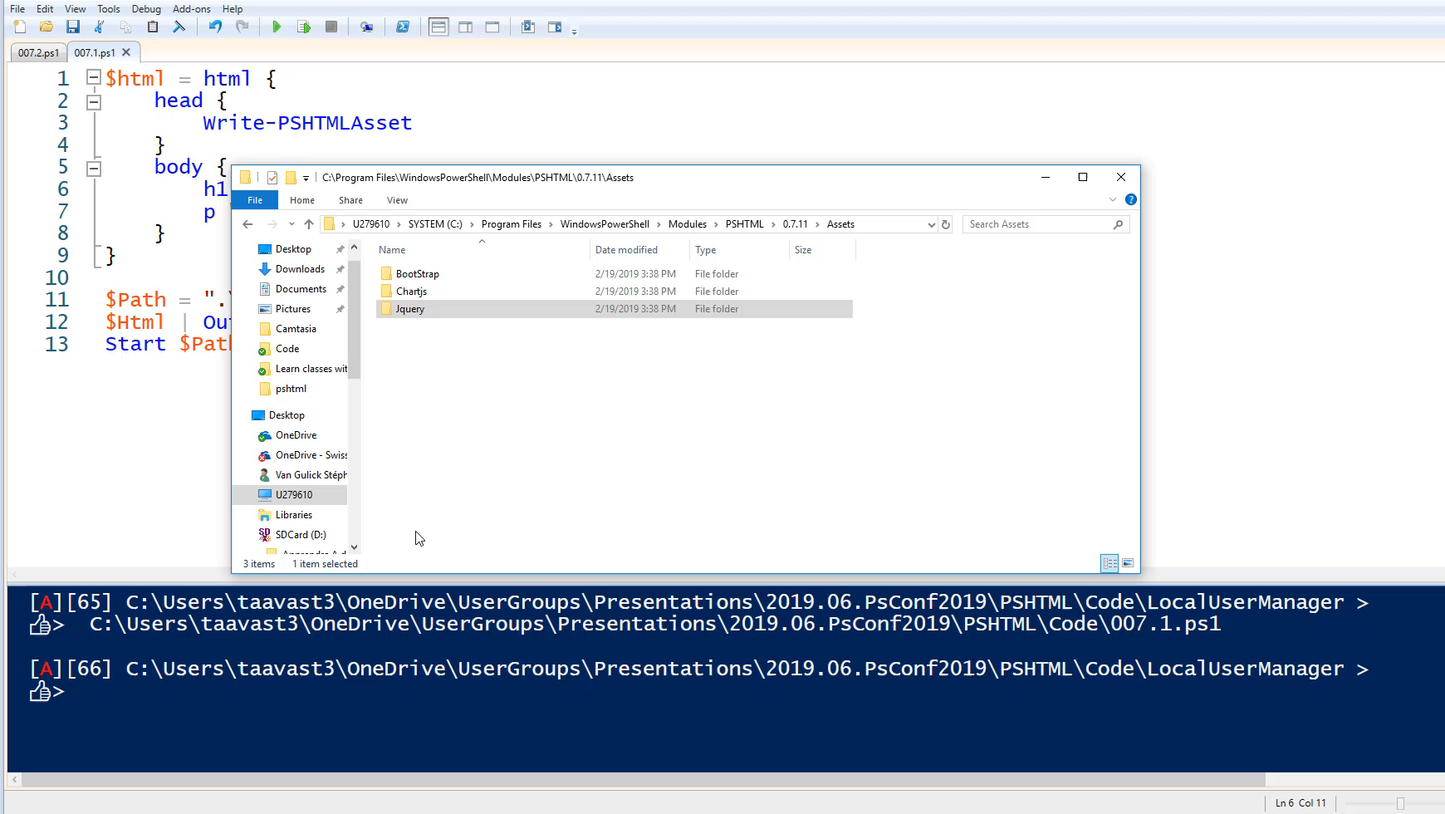

Slide 36
Making it look pretty
Using bootstrap

Slide 37
Twitter Bootstrap
Simplify styling
Responsive
Very popular in web dev community
Super easy to use

Slide 38
Developing with PSHTML and Bootstrap

Slide 39
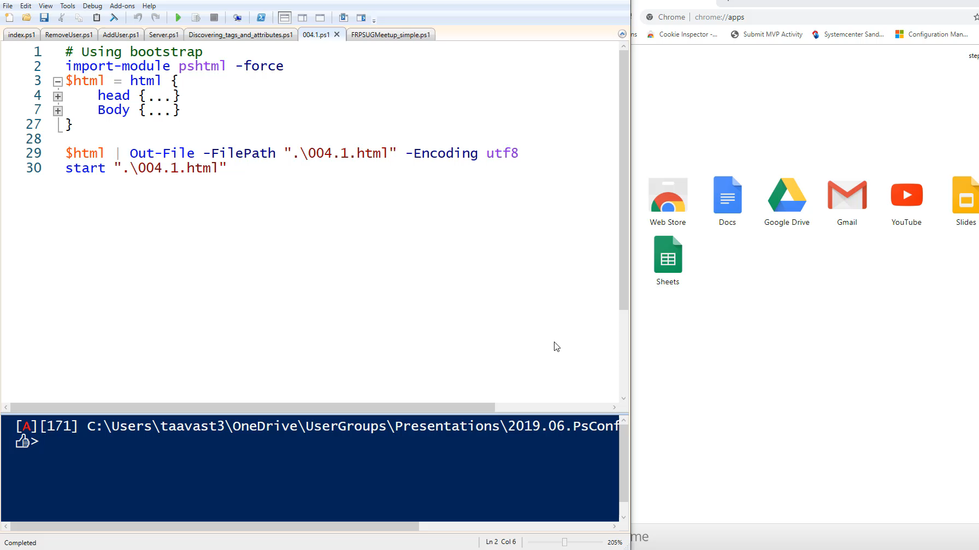
Notes:
1min59

Slide 40
Generating Charts in PSHTML
Using Chart.js

Slide 41
PSHTML Charts
Since version 7.1
Uses chart.js library
Draws the charts on canvas

Slide 42
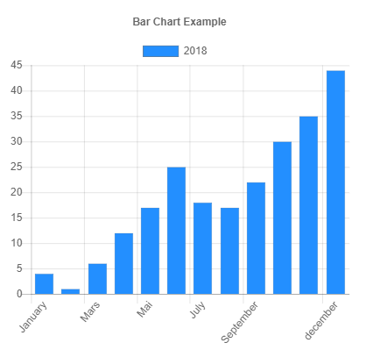
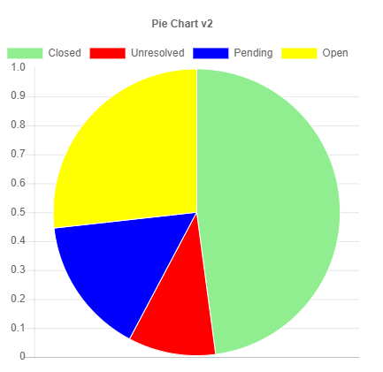
PSHTML Charts

Slide 43
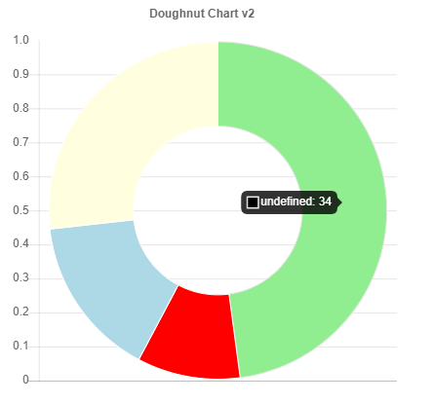
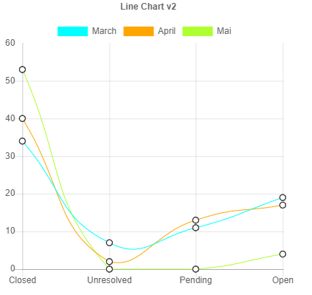
PSHTML Charts

Slide 44
PSHTML Charts
Script
Data
2,0,1,4,2
DataSet
Data
Label
Colors
Chart
DataSet
Labels
CanvasID
Notes:
$dsb2 = New-PSHTMLChartBarDataSet -Data $data2 -label "April" -BackgroundColor ([Color]::red)
$dsb3 = New-PSHTMLChartBarDataSet -Data $data3 -label "Mai" -BackgroundColor ([Color]::Green )
New-PSHTMLChart -type bar -DataSet $dsb1,$dsb2,$dsb3 -title "Bar Chart v2" -Labels $Labels -CanvasID $BarCanvasID

Slide 45
PSHTML Charts

Slide 46
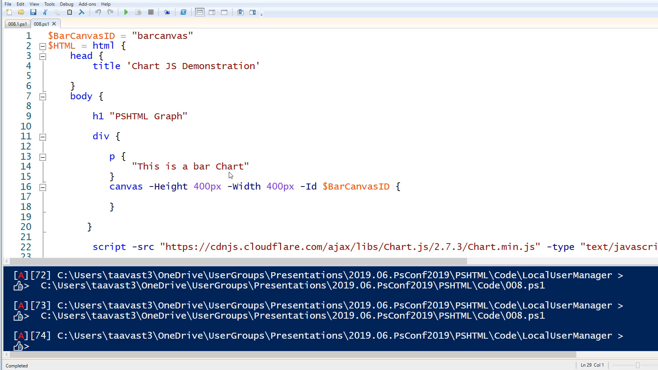
Notes:
1m14
Simple bar Chart
Generate 4 charts

Slide 47
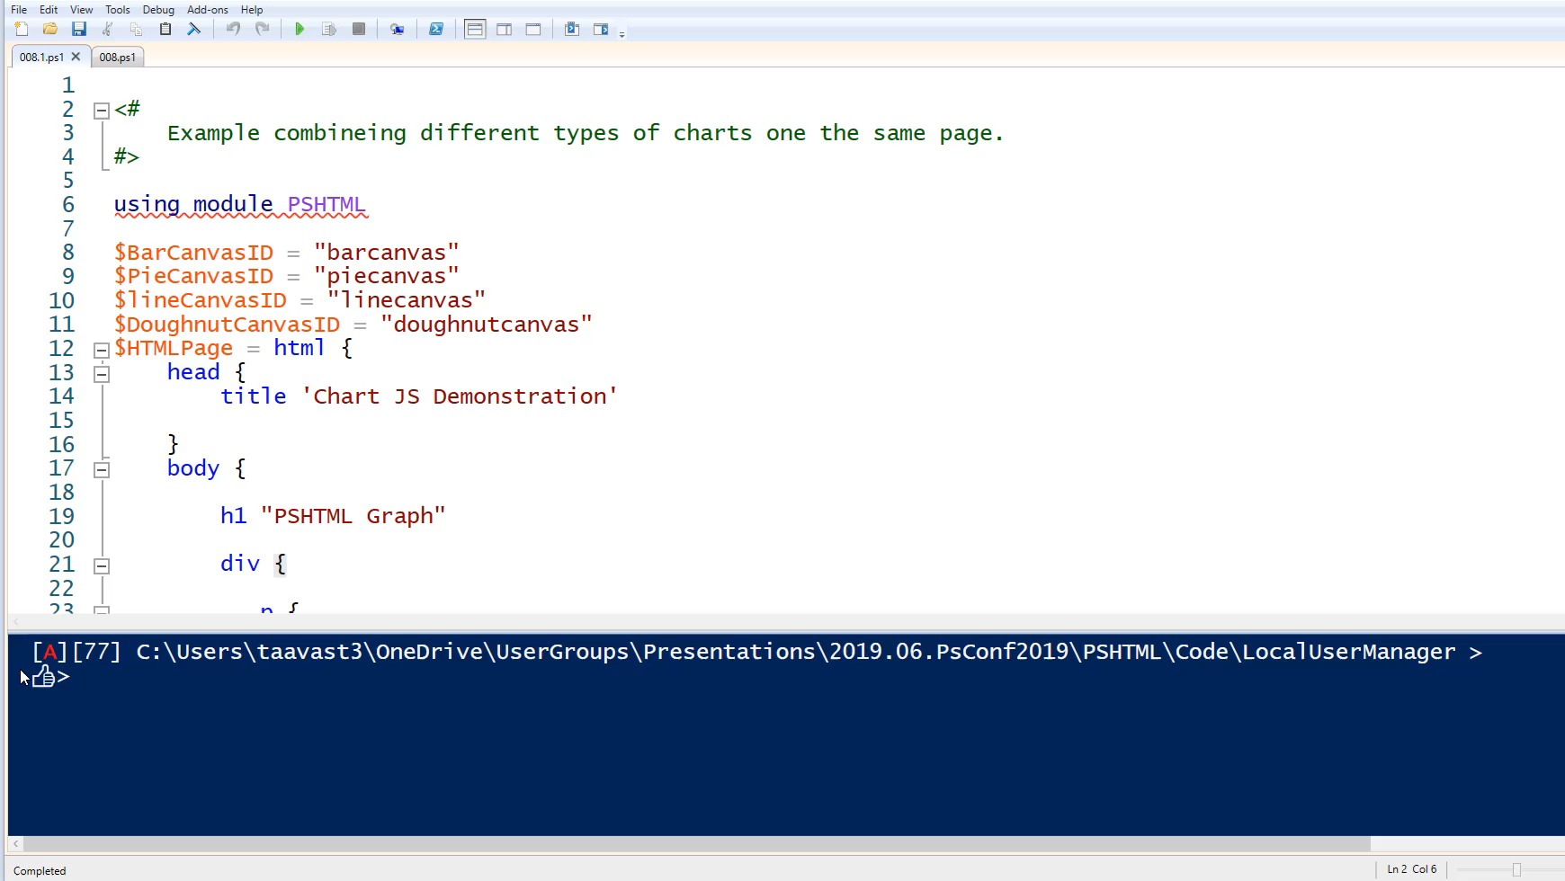

Slide 48
Combining everything together

Slide 49
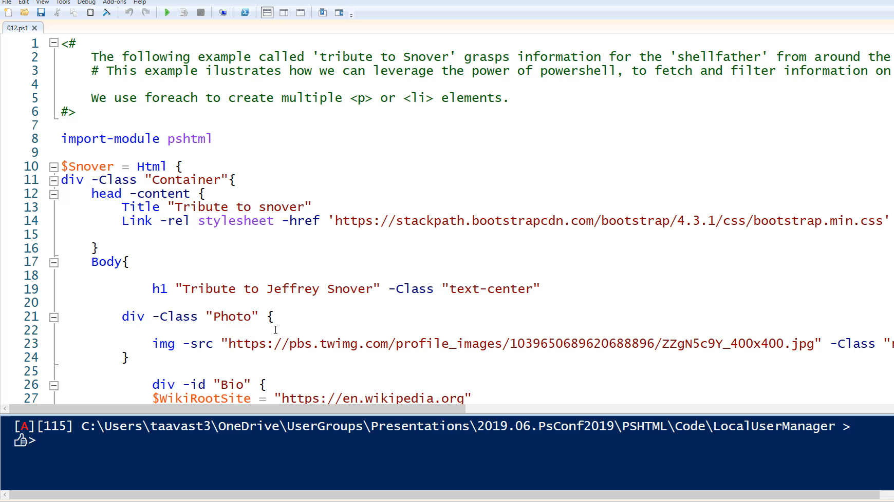
Notes:
Snoverism
Meetup data page

Slide 50
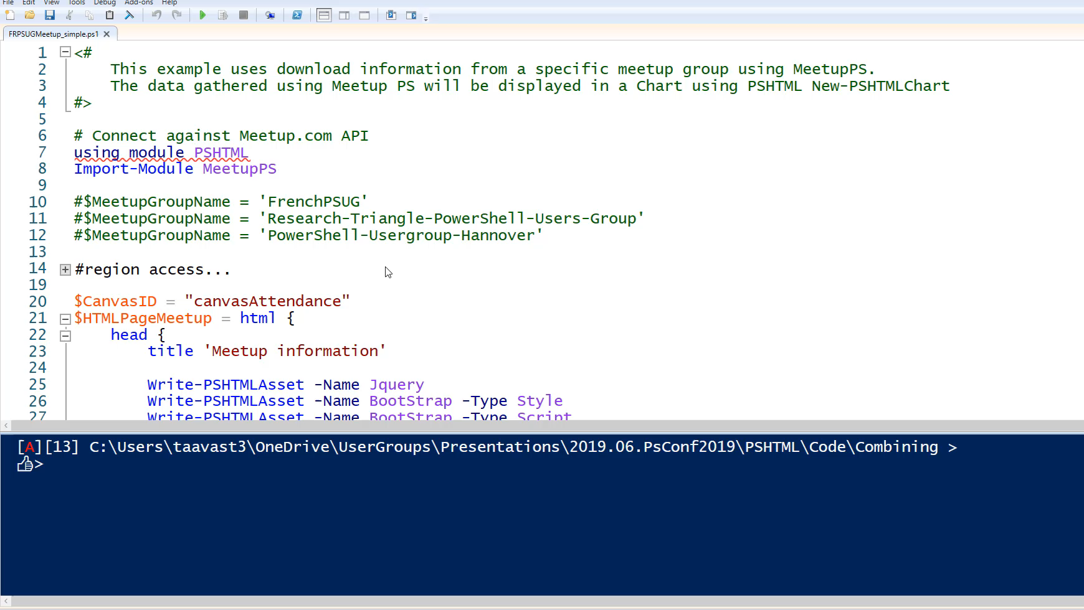
Notes:
1min39

Slide 51
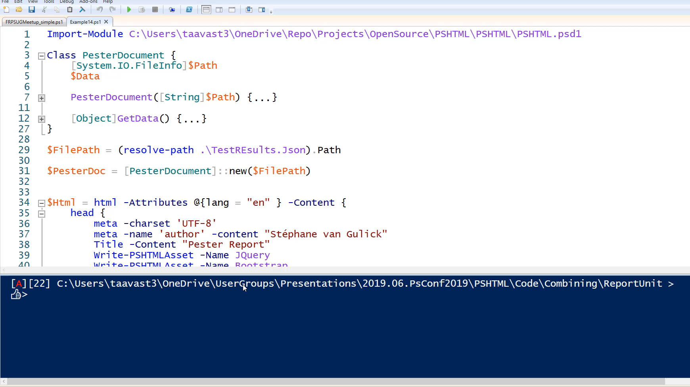

Slide 52
Snippets

Slide 53
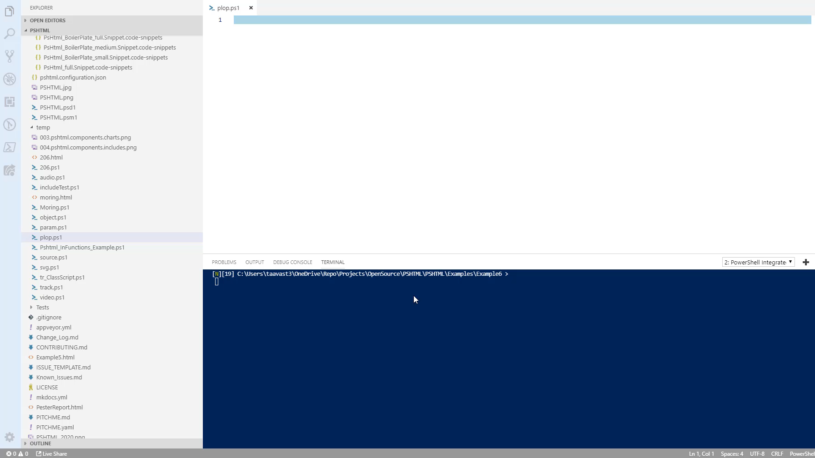
Notes:
36s

Slide 54
Introduction to Polaris
Creating the backend

Slide 55
Polaris
A cross-platform, minimalist web framework for PowerShell
Open source project (MIT)
Tyler Leonhardt - @TylerLeonhardt / Micah Rairdon - @tiberriver256
https://github.com/PowerShell/Polaris

Slide 56
Introduction to Polaris

Slide 57
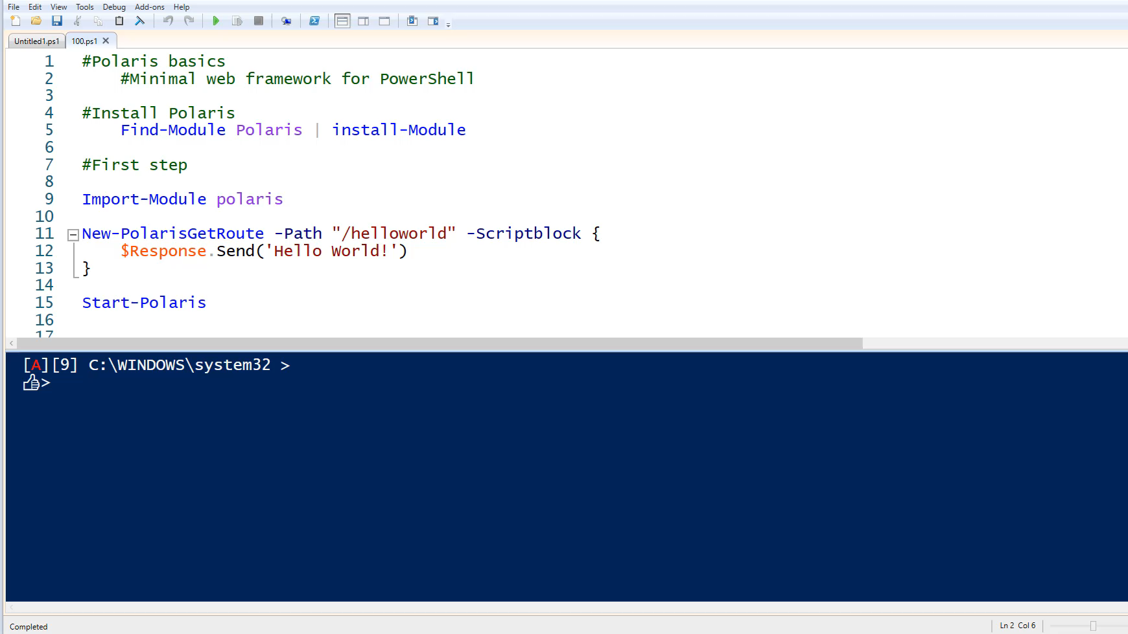

Slide 58
Create routes : New-PolarisRoute –Method
GET,POST,DELETE,PUT
Set content type
Text/plain
Text/json
Text/html
Publish static files : Publish-StaticRoute (optional)
Start the server : Start-Polaris

Slide 59
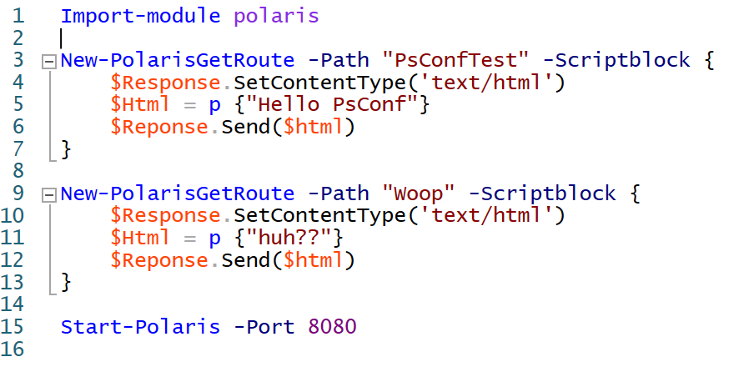

Slide 60
Combining PSHTML + Polaris

Slide 61
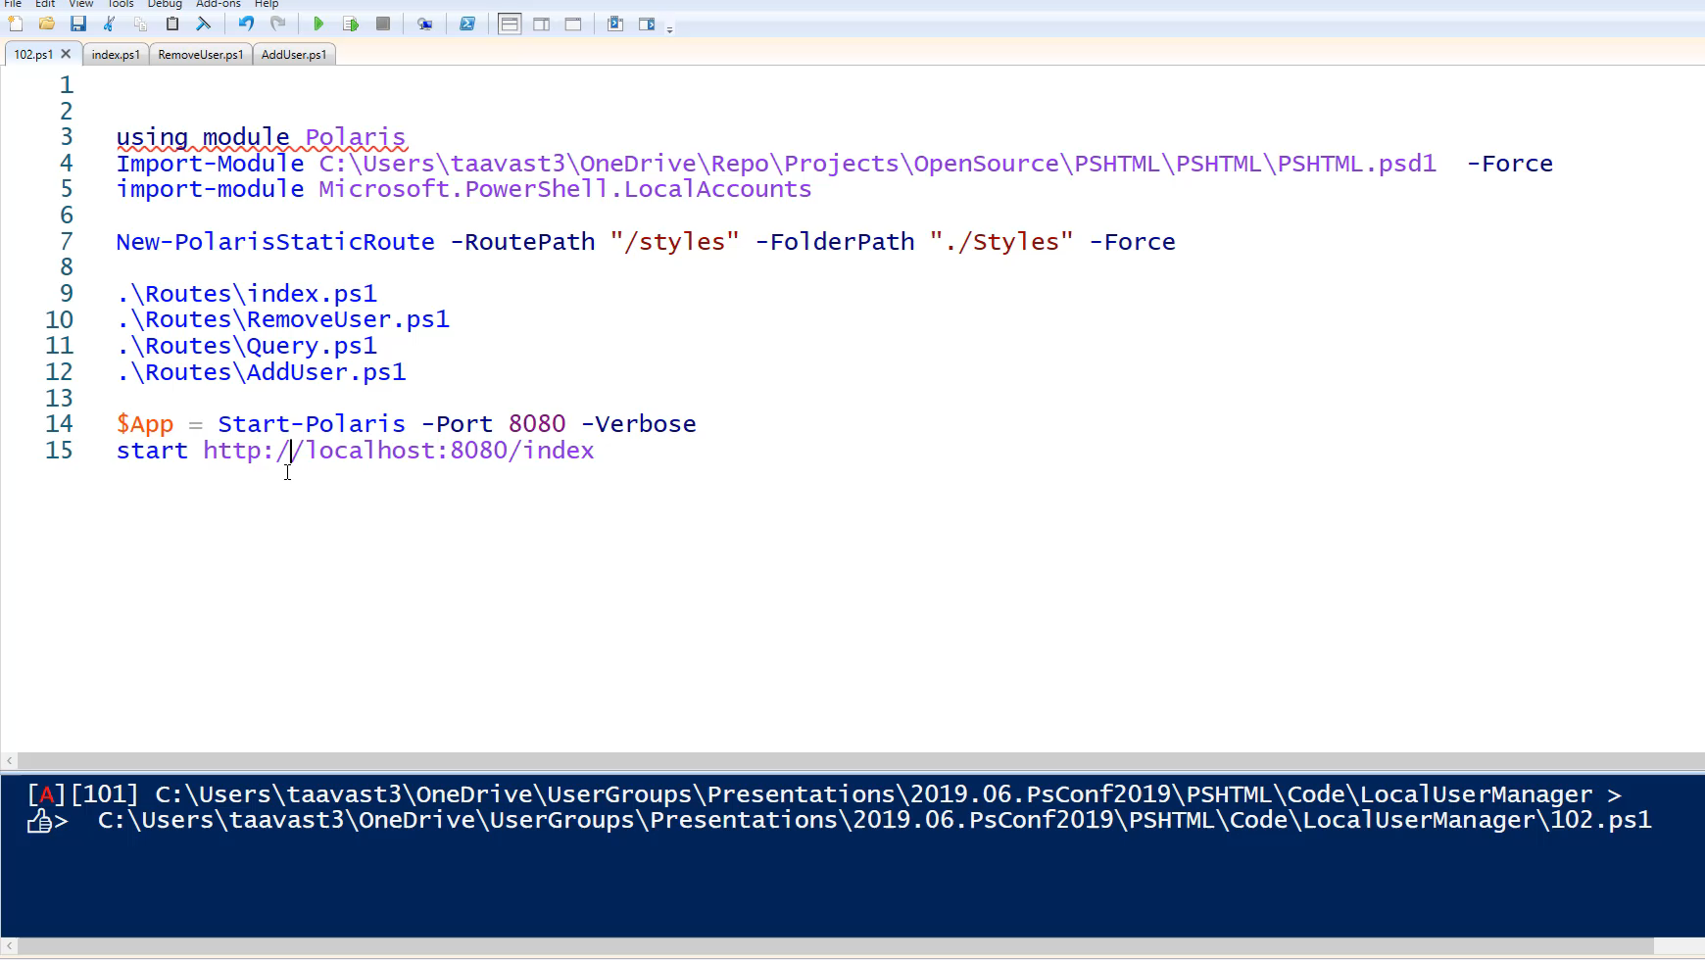
Notes:
1min47

Slide 62
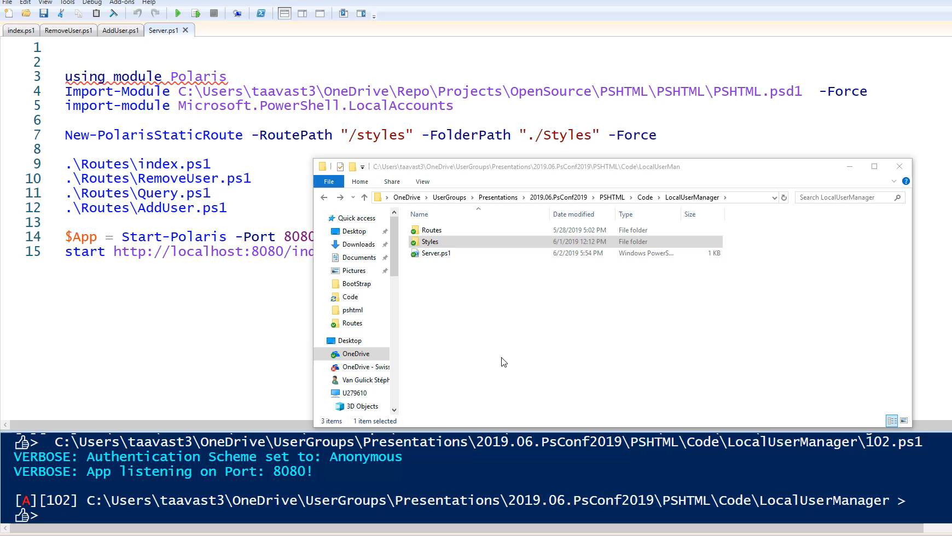
Notes:
2min35

Slide 63
PSHTML in the field
Projects using PSHTML in production / open source projects

Slide 64
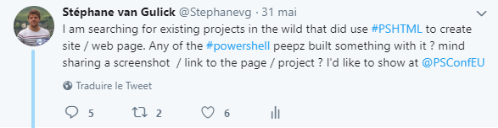

Slide 65
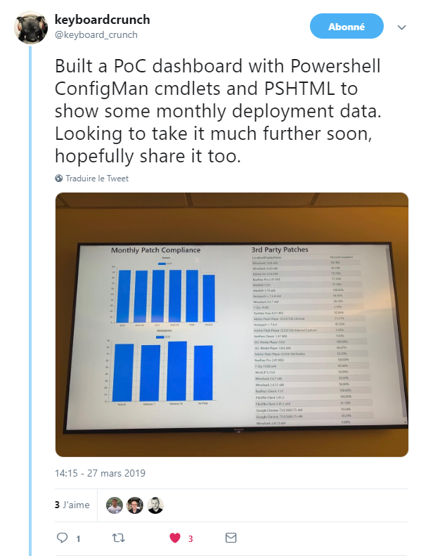

Slide 66
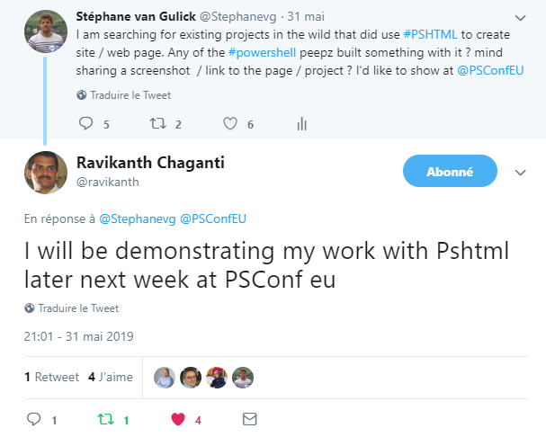

Slide 67
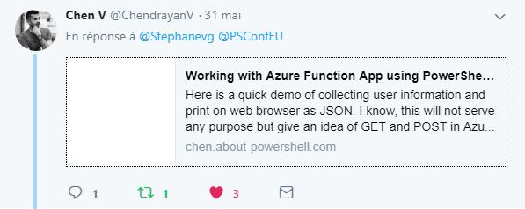
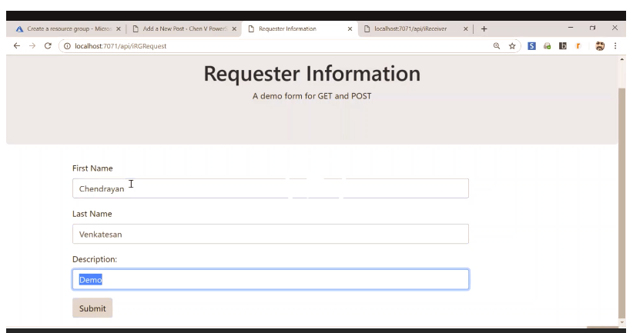

Slide 68
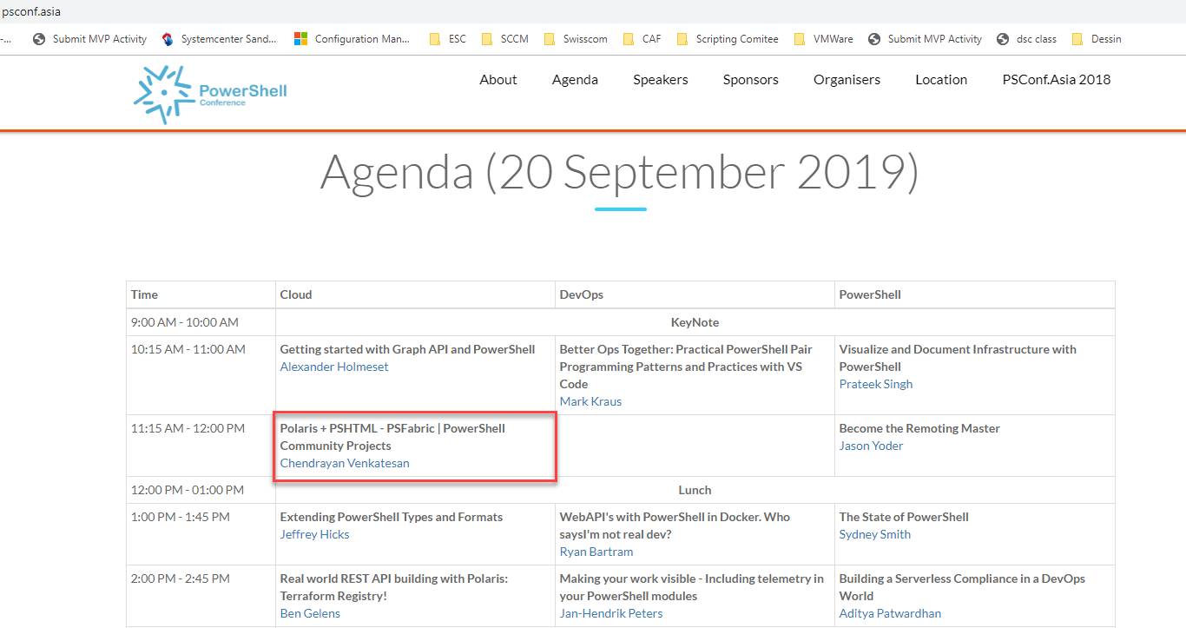

Slide 69
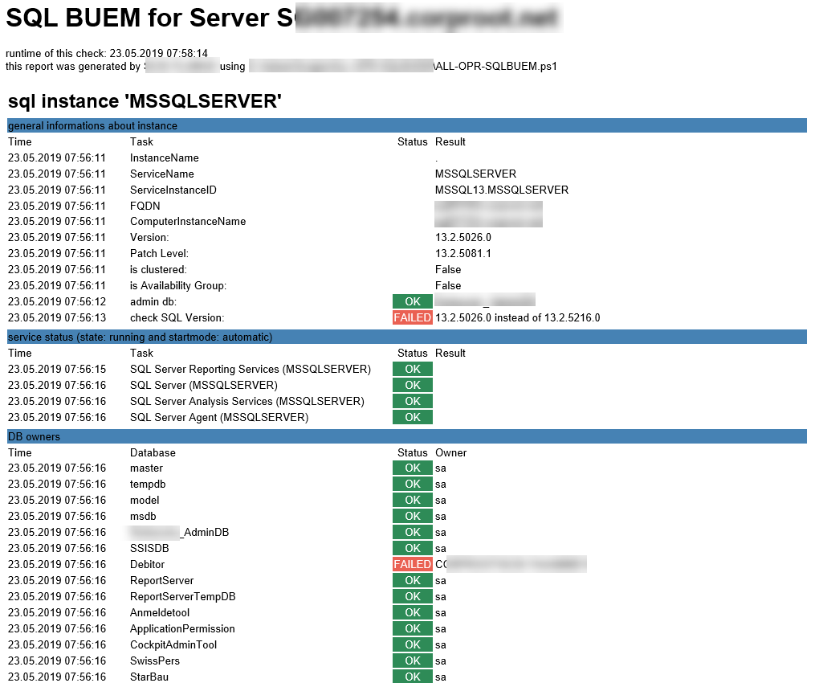

Slide 70
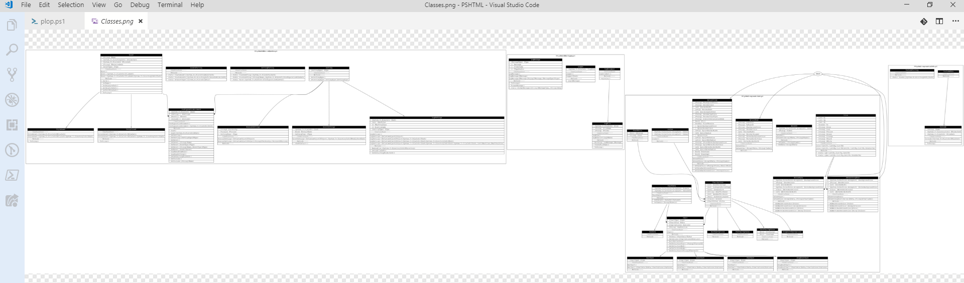
PSHTML Structure
Thursday 8h30 – Leibniz Room

Slide 71
Summary
Basics of PSHTML
Basics of Polaris
Used assets
Created Charts
Used existing modules
Created static pages
Create dynamic web pages
Created a web application
Notes:
Sum up your key messages

Slide 72
Links
Read the docs -> https://pshtml.readthedocs.io/en/latest/
Github -> https://github.com/Stephanevg/PSHTML
PSHTML and NodeJs -> http://chen.about-powershell.com/2018/12/experiment-using-pshtml-in-node-js-and-host-a-azure-web-app/
PSHTML and GO -> http://chen.about-powershell.com/2019/01/build-web-app-using-powershell-pshtml-module-in-go-lang/
Polaris -> https://github.com/PowerShell/Polaris

Slide 73
Notes:
[REQUIRED SLIDE]
Make sure you provide all materials that audience needs to reproduce your demos.
Either upload them as a PowerShell module to www.powershellgallery.com (preferred for reusable functions)
Or, upload them to our github repository (ask the girls at the info desk to provide you with access)
Or, upload them to your own github repository
Please make sure all materials are available by the time your presentation starts, or at minimum upload them right after your presentation

Slide 74
Notes:
[REQUIRED SLIDE]
If you sticked to your timing, you now have 15 min left for Q&A. If you missed your timing, you will have to leave the room when your slot is over. In this case, invite your audience to the coffee break and offer to cover questions there.
IN ANY CASE please point your audience to the conference app and the session voting. By the time the conference opens, the eventraft app *should* have the option to vote on sessions.
Please MAKE SURE you leave your room when your slot is over. The next speaker would like to set him/herself up and get everything up and running.

Slide 75
about_Speaker
Feel free to add information about yourself
You may advertise yourself or your company
Keep this slide at the end of your presentation
Do not use presentation time for your bio
Instead, your bio is published in the conference materials
Notes:
Do not EVER discuss this slide during your presentation. Please do not take presentation time to talk about yourself more than just a few introductory sentences. Instead, invite interested audience to the coffee break, and then talk about yourself, your job, your services, etc.
Use this slide to sum up your details. It will be part of the conference materials and recorded videos.

